Slide 1

Pythonization Reading
Feb 2020 Portland, OR, USA
MPI Forum Meeting

Slide 2

New things since ABQ
All Chapter Committees have reviewed
Gave up on “little improvements” for language-independent bindings E.g., “integer” → “non-negative integer”
“Returned to roots” 1-to-1 comparison against mpi-4.x branch HEAD before Pythonization

Slide 3
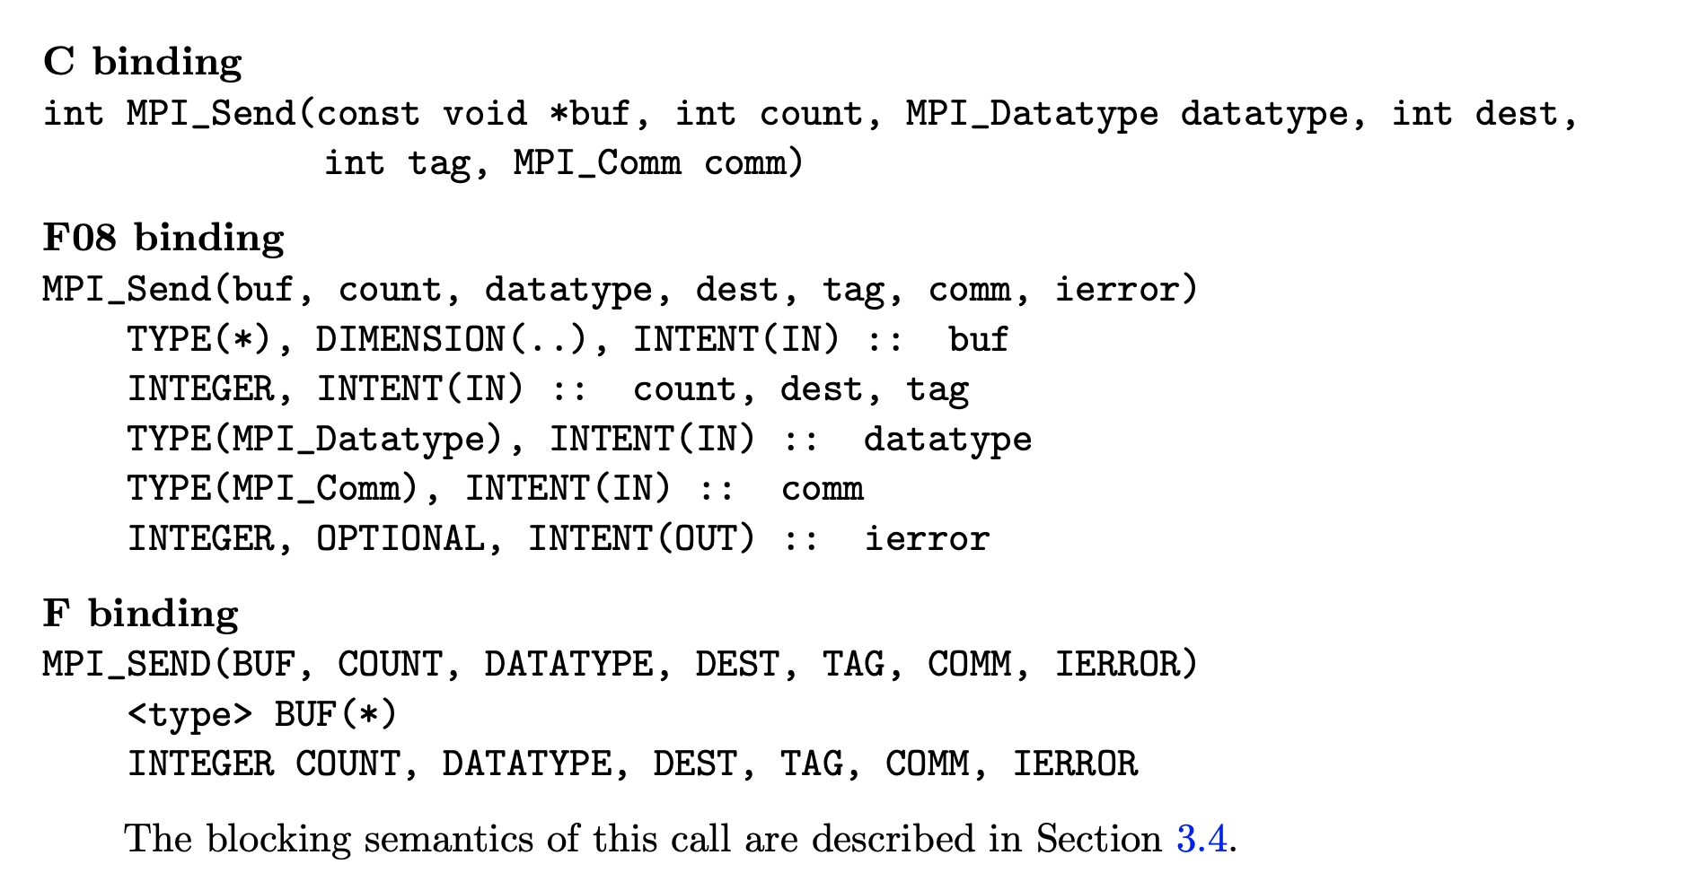
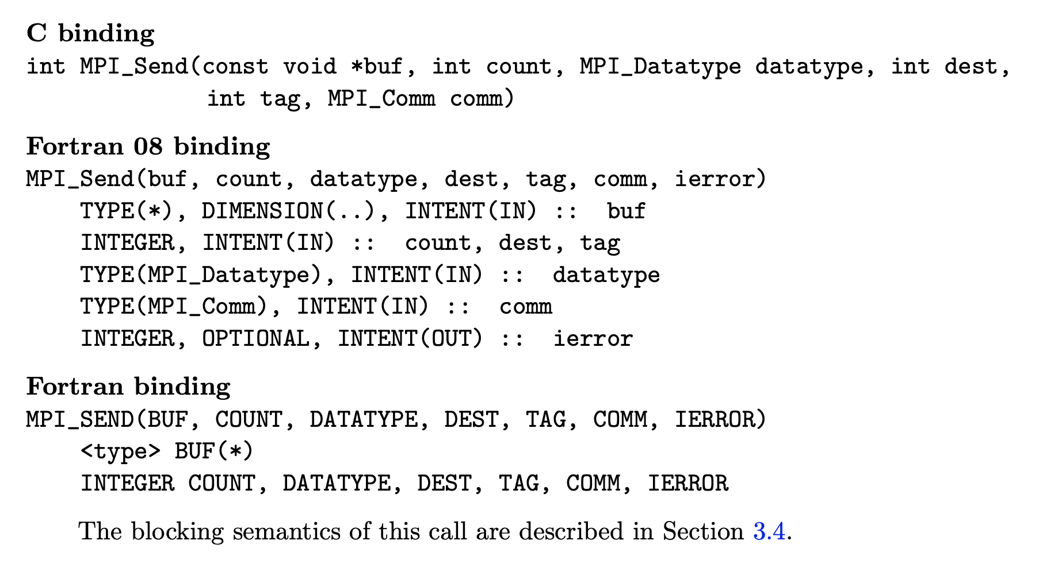
New things since ABQ
“F” → “Fortran” in the bindings listings

Slide 4
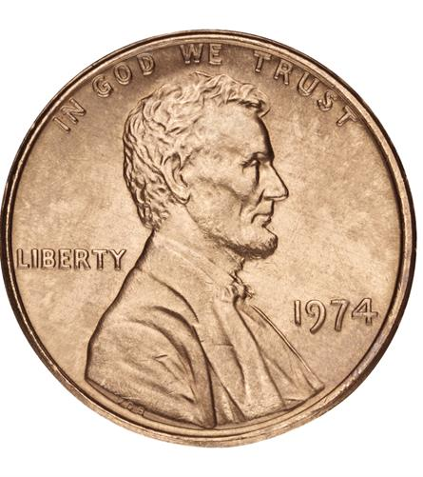
Ticket 0 changes only
Whitespace changes
Grammar changes
Fortran parameter order changes
No semantic changes at all

Slide 5

The goal of this Reading
Merge Pythonization at (or immediately after) this meeting (meaning: the mpi-4.x branch HEAD will be fully Pythonized)

Slide 6
All future PRs must be Pythonized
If your PR isn’t yet merged, you have to Pythonize it
To learn how to Pythonize:
Wiki documentation
Jeff will help you here at this Portland meeting
It will be a LOT easier if we merge Pythonization at this meeting!
If you’re adding a new chapter
You have to do the usual Makefile modifications
If you’re adding new “kinds”
Edit binding-tool/bindingtypes.py
Please talk to Pythonization group if you have to do this

Slide 7

PR authors: you’re going to have git conflicts
All the bindings changed
If you have text changes near bindings, you may have conflicts
If you have git merges in your history and you try to rebase...
Kaboom
Advice: stay with merges OR stay with rebases

Slide 8

Post-Portland Pythonization Plans (P⁴)
Publish machine-readable MPI API specifications
JSON
C mpi.h file
Fortran mpif.h file, mpi and mpi_f08 modules
…?
CI for MPI Forum GitHub pull requests
Improving the Python “KIND” list
Language Independent Specifications (LIS) errata
Datatype errata
...see https://github.com/mpiwg-large-count/large-count-issues/wiki/TODOs

